Slide 1
Group – 11
Aaron Reji
Aditya DamodaraA
Harsh Javia
Intesar Hasan Nahin
Md Abtab Karim Kabbo
Nishaanth Govindaraj
Vandana Rajagopal

Slide 2
Stakeholder Hat -- NSW Minister for Better Regulation and Fair Trading. Group
The Bond Penalty
A data-driven investigation into postcode-level inequality in NSW's rental bond system.
NSW Fair Trading bond records (2025) | ABS SEIFA 2021 | 636 postcodes | 303,111 lodgements
DVN Group | Assignment 3, Part 2 | May 2026
303,111
310,428
636
1–10
bond lodgements
refund records
NSW postcodes
SEIFA deciles
Notes:
SLIDE 1 -- TITLE (~20 sec) "Good afternoon, Minister. Today we'd like you to put on a specific hat -- the NSW Minister for Better Regulation and Fair Trading. We spent the past few weeks pulling apart 303,000 rental bond records -- data your own department publishes. We found a pattern. We're calling it: The Bond Penalty."

Slide 3
01 | THE ANOMALY
Decile 1 -- Most Disadvantaged
Decile 10 -- Most Affluent
37%
13%
vs
of their bond lost to the landlord
of their bond lost to the landlord
A renter in Mount Druitt or Greenacre.
A renter in Mosman or Killara.
Same statute. Same forms. Same Fair Trading process. The only variable is the postcode. The question that follows is the only one that matters: Why?
Notes:
SLIDE 2 -- HOOK (~30 sec) "Imagine two renters in NSW. Both signed the same standard lease. Both went through the same Fair Trading process when they left. Renter One is in Greenacre -- she loses 37% of her bond. Renter Two is in Mosman -- he loses 13%. Same Residential Tenancies Act. Same forms. Same state. The only difference is the postcode. That gap is what we're calling the bond penalty. And the question it raises is the only one that matters: why?"

Slide 4
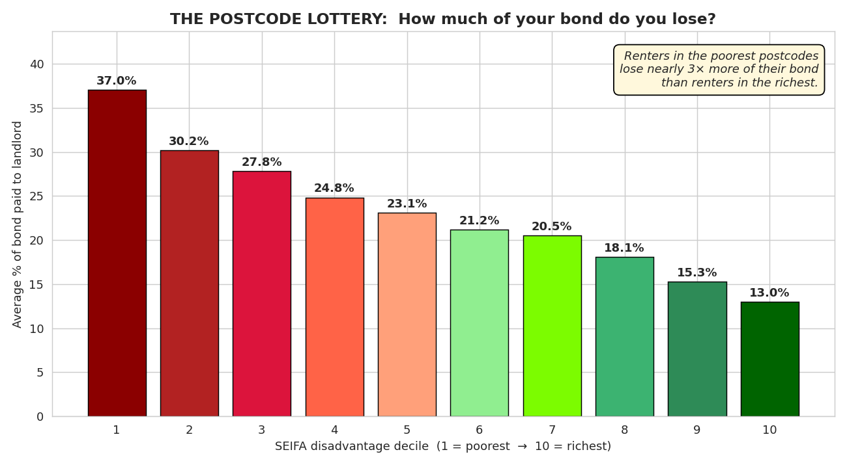
02 | THE EVIDENCE
Every step up the SEIFA ladder, renters lose less bond. The gradient is monotonic.
3x
the bond-loss rate.
There is no noise.
There is no caveat.
The variable is
the postcode.
Source: NSW Fair Trading bond records 2025 | ABS SEIFA 2021 | 303,111 lodgements across 636 postcodes
Notes:
SLIDE 3 -- EVIDENCE (~40 sec) "We matched 303,000 bond records to ABS SEIFA disadvantage scores across 636 postcodes. The SEIFA scale goes 1 to 10 -- 1 is most disadvantaged, 10 is most affluent. And the pattern is completely clean. Every single decile, bond loss falls. No noise. No outliers. The gradient is perfectly monotonic. Not a little different -- three times higher for the most disadvantaged postcodes compared to the most affluent. Same statute. Same forms. Same state. In any other policy context, a pattern this consistent would trigger an immediate review."

Slide 5
03 | THE PLACES
Less to lose. Lose more of it. Nowhere cheaper to go.
Auburn
2141
Burwood
2134
Chester Hill
2197
Greenacre
2190
$750/wk | Decile 2
$800/wk | Decile 2
$790/wk | Decile 1
$750/wk | Decile 1
Hurstville
2220
Padstow
2209
Tweed Heads
2485
Wetherill Park
2176
$730/wk | Decile 3
$690/wk | Decile 3
$700/wk | Decile 3
$700/wk | Decile 1
~200,000
These postcodes sit in SEIFA deciles 1-3 AND carry rents at or above the NSW median. There is no cheaper suburb nearby. Abstract deciles do not move ministers. Named suburbs do.
residents in these
8 squeezed postcodes
Source: NSW Fair Trading 2025 | ABS SEIFA 2021
Notes:
SLIDE 4 -- THE PLACES (~35 sec) "Let's put real names to this. These eight postcodes are what we call squeezed. They sit in the lower SEIFA deciles -- residents already face lower incomes and fewer economic resources -- but they also carry rents at or above $620 a week, the NSW median. There is no cheaper option nearby. High rent. High bond loss. Low income. These are not abstract postcodes. Auburn, Burwood, Greenacre, Chester Hill. About 200,000 people live here. These are the people who take the hit."

Slide 6
04 | THE CYCLE
The penalty does not happen once. It happens every 18.8 months.
564
30%
11%
days
median NSW tenancy
of tenancies end within a year
of tenancies reach 5 years
Roughly 18.8 months. Less than two years between bond hits.
A renter on this cycle pays the bond penalty every single year.
Long-term stability is the exception, not the norm. An owner-occupier never faces this.
An owner-occupier never takes this hit. A renter in a squeezed postcode takes it again, and again, and again.
Notes:
SLIDE 5 -- THE CYCLE (~30 sec) "Here's what makes this more than a one-time inconvenience. The median NSW tenancy lasts 564 days -- under two years. 30% of tenancies don't even make it past a year. And only 11% of renters ever reach five years -- stability is rare. So every time someone in these postcodes moves, the clock resets. They lose another slice of bond. An owner-occupier never takes this hit. A renter takes it again, and again, and again."

Slide 7
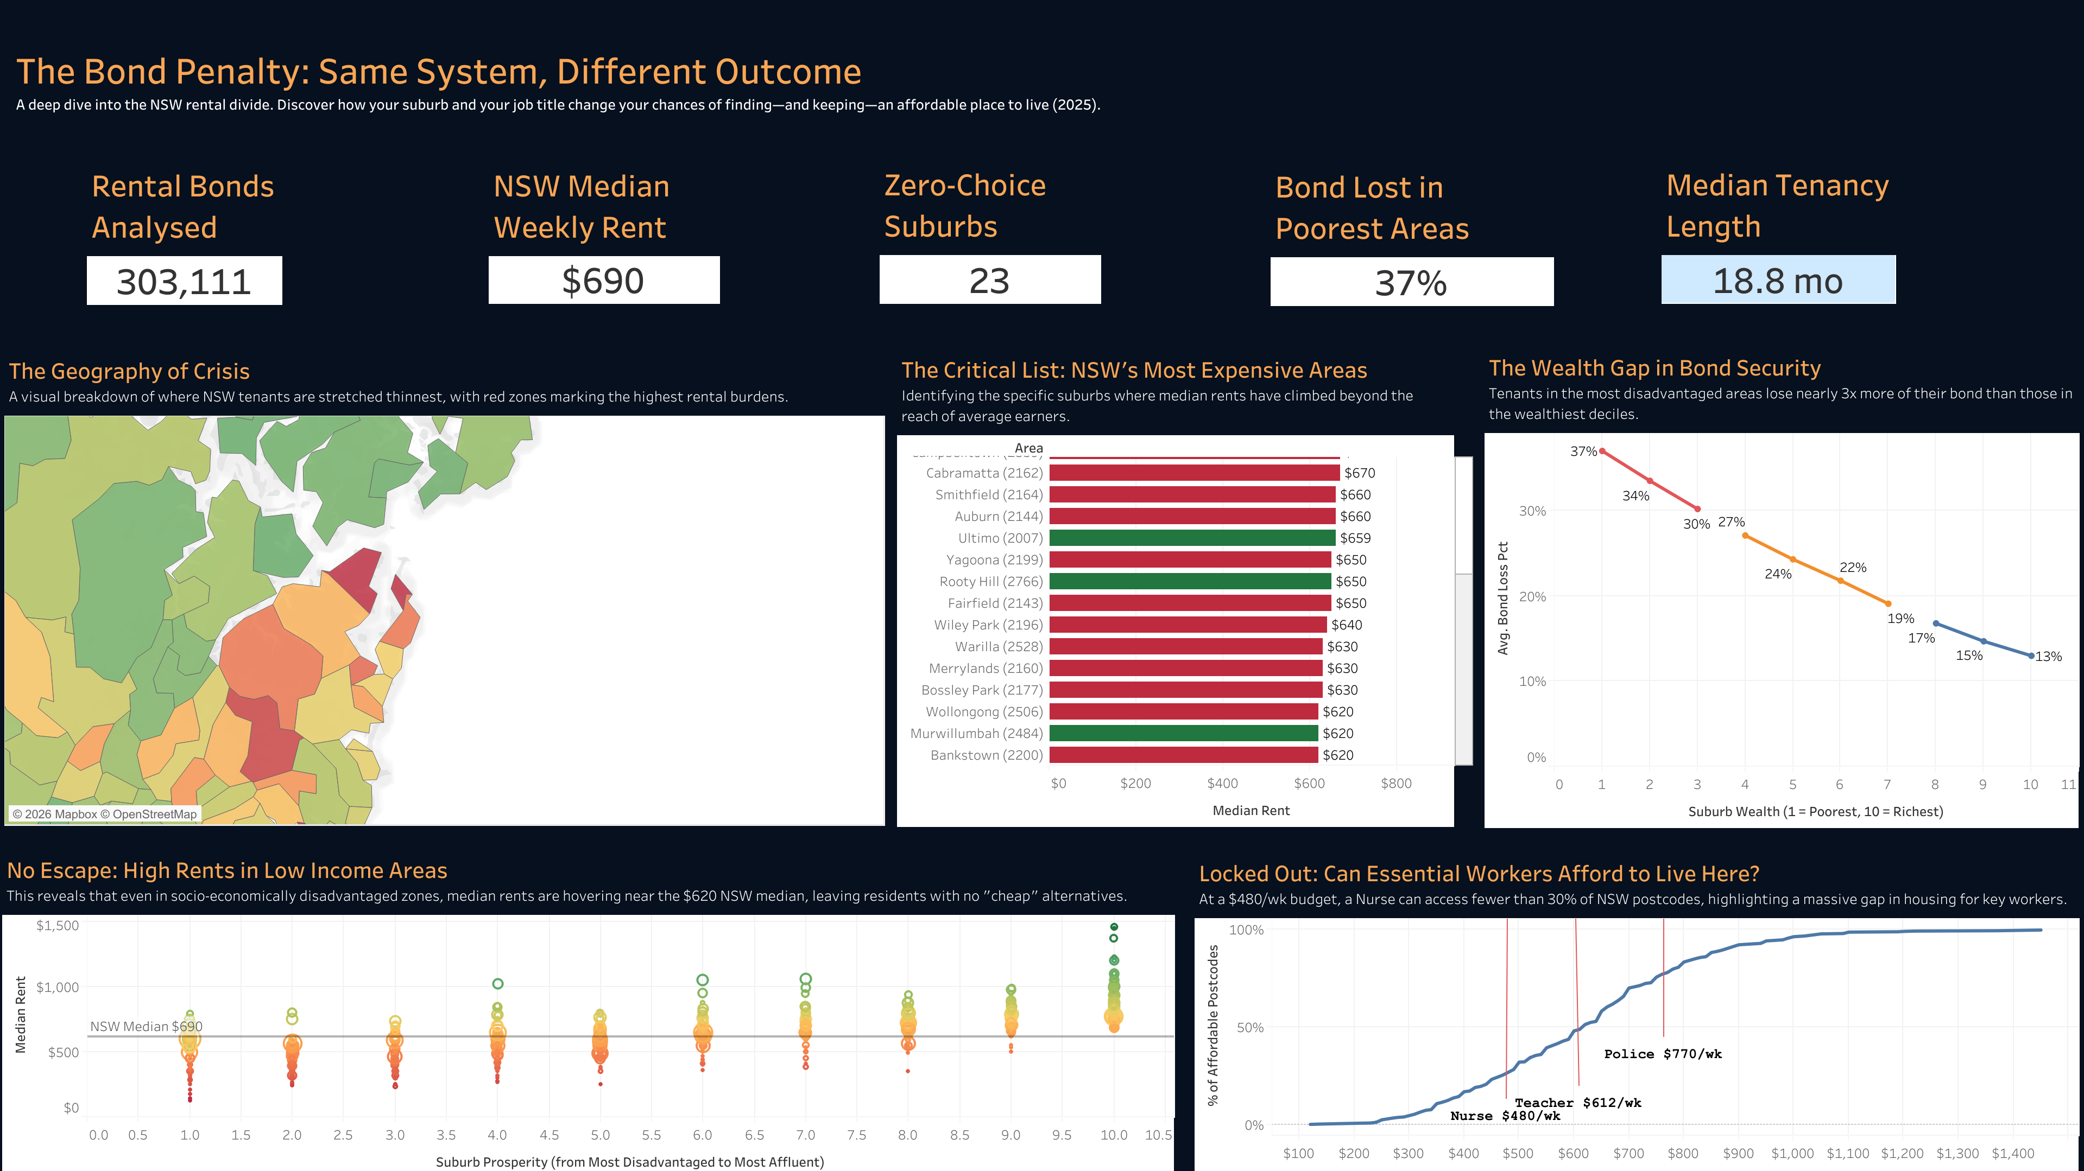
05 | THE PROTOTYPE
A decision-support tool. Not just a reporting dashboard.
Bond loss by SEIFA decile
The gradient across all 10 deciles. Monotonic, undeniable.
Geography of Crisis map
NSW postcode map. Red = where renters are stretched thinnest.
Zero-choice suburbs
23 specific postcodes named. High rent + disadvantaged SEIFA.
No Escape scatterplot
Rent vs disadvantage for 636 postcodes. The squeezed cluster is visible instantly.
Essential worker curve
Budget slider: drag to $480/wk -- nurse salary -- watch the map turn red.
tableau.com > ”The Bond Penalty: Same System, Different Outcome"
https://public.tableau.com/app/profile/md.abtab.karim.kabbo/viz/TheRentersTaxNSW/Dashboard1?publish=yes
Notes:
SLIDE 6 -- PROTOTYPE (~40 sec) "This is our live Tableau dashboard. [Open it now.] Five coordinated visuals. The bond-loss gradient is the first thing you see. The map shows you exactly which postcodes are worst affected. The zero-choice suburbs list names 23 specific areas. The scatterplot shows all 636 postcodes at once -- rent against disadvantage -- and the squeezed cluster is obvious. And the essential worker curve is interactive: drag the budget slider to $480 a week -- a nurse salary -- and watch in real time as most of NSW becomes unaffordable. This is not a static report. It is a targeting tool. If you want to know where to intervene first, this dashboard answers that."

Slide 8
06 | THE FIX
Three implementation-ready actions within the Minister's existing authority.
NOW | 0-3 months
THIS YEAR | 3-12 months
LEGACY | 12-18 months
Mandatory itemised deductions
Quarterly public reporting
Tenant-favour presumption in SEIFA 1-3
MECHANISM
MECHANISM
MECHANISM
Amend Residential Tenancies Regulation 2019, Schedule 1. Order-in-Council -- no legislation required.
Departmental reporting directive. Publish bond outcome rates by postcode to the NSW Open Data Portal each quarter.
NCAT procedural direction + RTA s.187 amendment. Pilot in the 8 named squeezed postcodes first.
100% of bond claims itemised
Bond-loss gap below 2x by Q4
Decile-1 bond loss 37% to 20% by 2028
Notes:
SLIDE 7 -- ACTIONS (~45 sec) "So what do we actually want? Three things, all within the Minister's existing mandate. Right now: mandate itemised deductions. If a landlord withholds bond, they need photographic evidence and a line-by-line breakdown. No evidence means no deduction. This is an Order-in-Council -- it does not need new legislation. This year: release the data. Fair Trading already collects it. Publishing bond outcomes by postcode quarterly is a reporting directive. It costs nothing. And as a lasting reform: a tenant-favour presumption in the squeezed postcodes. In NCAT disputes in SEIFA decile 1-3 areas, the burden of proof shifts to landlords. Pilot it in the 8 named suburbs first. Measurable within six months."

Slide 9
The data tells us exactly which postcodes need intervention,
how big the gap is, and who pays the price.
What is missing is the will to act.
MODELLED
OBSERVED
OBSERVED
OBSERVED
$15.6M
65,140
194
2.1M
bond recoverable
per year
bond lodgements
in deciles 1-3
targeted
postcodes
residents
at stake
Dashboard: tableau.com > ”The Bond Penalty: Same System, Different Outcome"
Notes:
SLIDE 8 -- CLOSE (~20 sec, then Q&A) "The data tells us exactly which postcodes need intervention, how big the gap is, and who pays the price. What is missing is the will to act. $15.6 million in bond is recoverable every year if the gap narrows. 2.1 million residents are in scope. 194 postcodes are already identified. Minister, the evidence is on your desk. The next move belongs to your office." Q&A PREPARATION (1.5 minutes): Q1: "Why use SEIFA? Isn't it an indirect measure?" SEIFA is the ABS standard for geographic equity analysis -- used by every government department. We're not claiming it causes bond loss; we're observing it predicts it with remarkable consistency across all 10 deciles and 636 postcodes. Q2: "Couldn't this just be worse properties getting more damage?" If it were property damage, we'd expect noise and outliers. The gradient is perfectly monotonic. That's not what random damage looks like. The 3x gap is too large and too consistent to explain through property condition. Q3: "NCAT already handles this -- why isn't it working?" NCAT only helps if tenants dispute. Disadvantaged renters are far less likely to challenge decisions -- due to time pressure, legal unfamiliarity, or fear of reference checks. The system is technically available but practically inaccessible. Q4: "What exactly should the Minister do first thing Monday?" Day 1: direct Fair Trading Commissioner to validate the finding from internal records. Week 1: sign the Order-in-Council on itemised deductions. Month 1: publish the first postcode-level bond outcome dataset to the Open Data Portal. Q5: "What are the limitations of the data?" We observe outcomes -- how much was returned -- but not the stated reason for deductions. That's part of the policy argument: mandatory itemisation would fill exactly that gap.

Slide 10
Thank you.
We welcome your questions.
DVN Group | Assignment 3, Part 2 | May 2026
Dashboard: tableau.com > ”The Bond Penalty: Same System, Different Outcome"
Notes:
SLIDE 9 -- THANK YOU Present this slide during Q&A. Keep the dashboard link visible so the audience can access it directly.

